Slide 1
The Cardiac Cycle and Pressure Changes
Thomas Bailey and Alex Ganderton
Notes:
<!DOCTYPE html>
<html>
<a href=“http://www.google.co.uk”>Google</a>
</html>

Slide 2
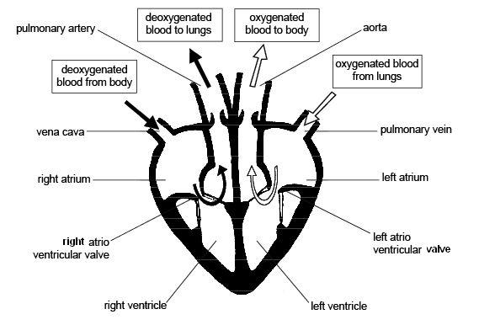
The Cardiac Cycle

Slide 3
Diastole - Relaxation
All Four Chambers of the Heart Relax.
Vena Cava carries De-Oxygenated Blood to Heart.
Right Atria begin to fill with De-Oxygenated Blood.
Pulmonary Artery carries Oxygenated Blood to Heart.
Left Atria begins to fill with Oxygenated Blood.
AV-Valves are forced open as Atrial Pressure exceeds Ventricular Pressure → blood trickles from Atria into the ventricles.
Semi-Lunar Valves Close preventing back flow.

Slide 4
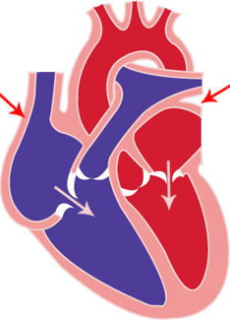
Atrial Systole
The Atria Contract → Causes pressure increase in Atria.
Forces any remaining blood into ventricles.
Muscular Walls are quite thin due to short
blood travel distance.
Systole → Contracting

Slide 5
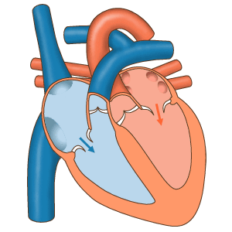
Ventricular Systole
Ventricles Contract → Causes pressure increase in Ventricles
As Ventricular pressure exceeds Arterial pressure the semilunar (Aortic/Mitral) valves which open
Blood is forced into Arteries
(Aorta/Pulmonary Artery).

Slide 6
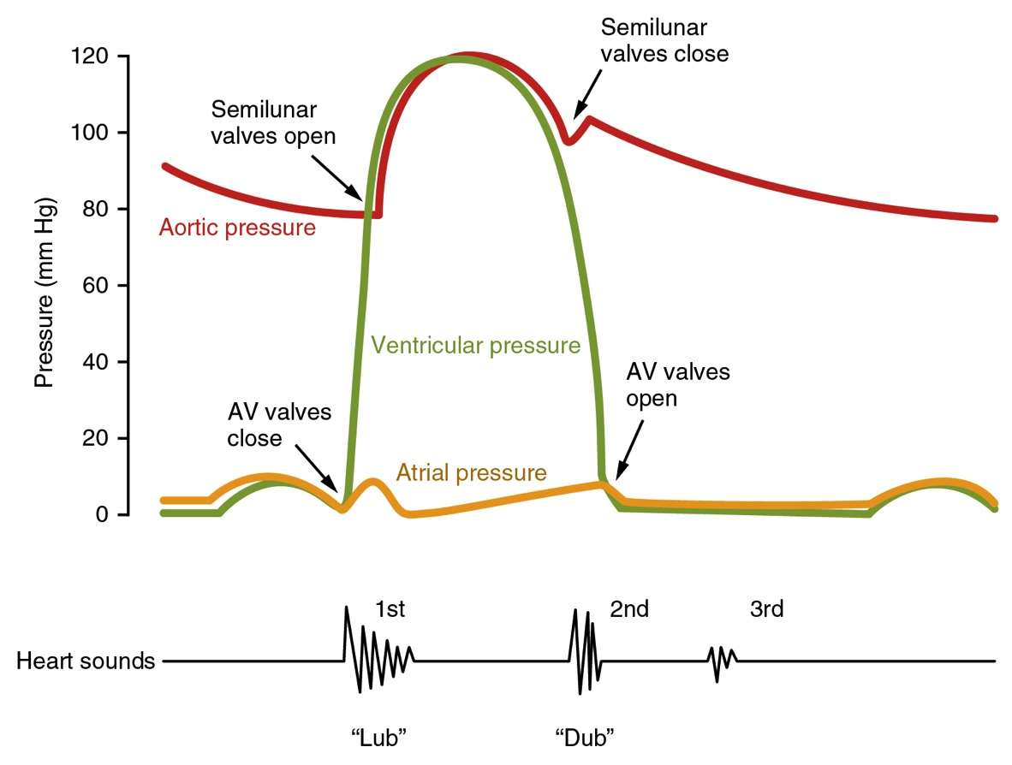
Pressure Changes During the Cardiac Cycle

