Slide 1
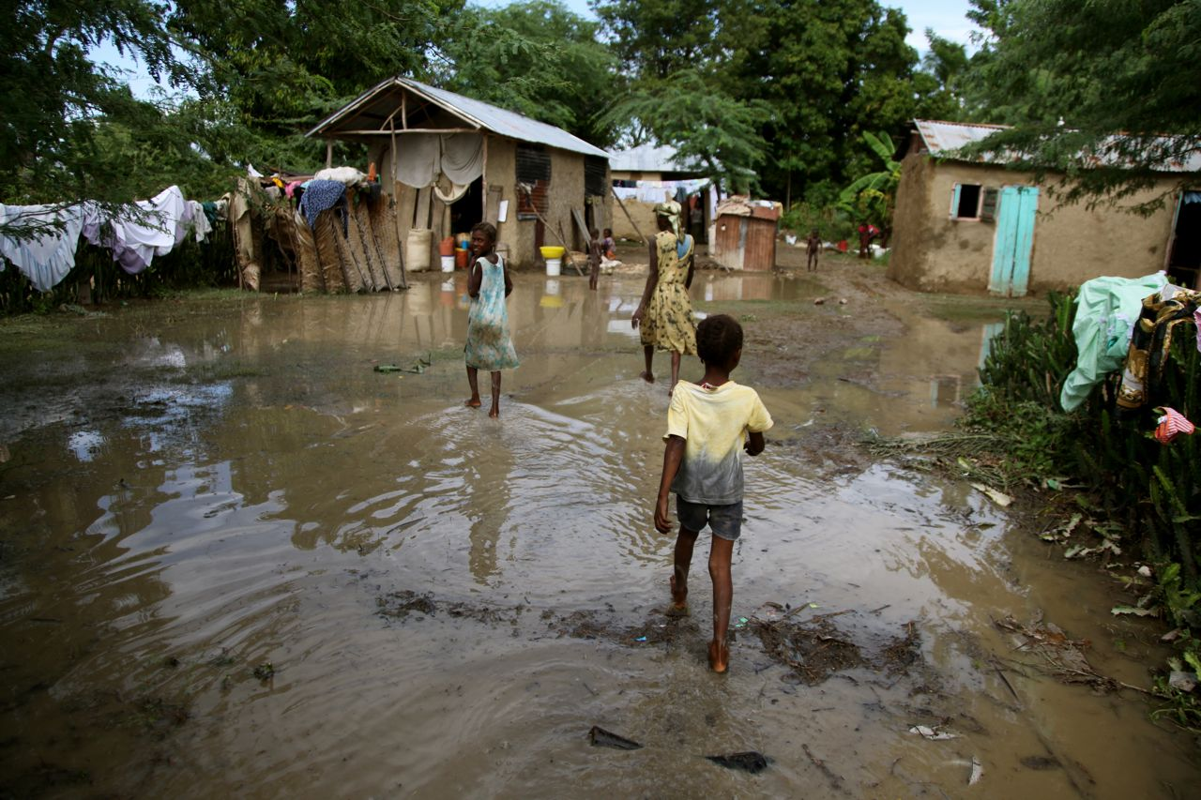
How the cholera bacterium causes disease
What is cholera and how do the symptoms arise?
Poor sanitation
Inadequate sewage system
Lack of clean water
Houses lack basic facilities
Crowded living conditions

Slide 2
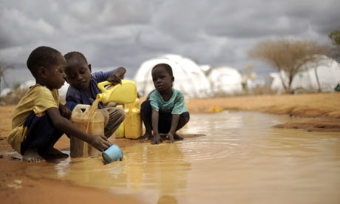
Cholera
What is cholera and how do the symptoms arise?
Cholera bacteria are ingested by humans through faecal contaminated food or water.

Slide 3
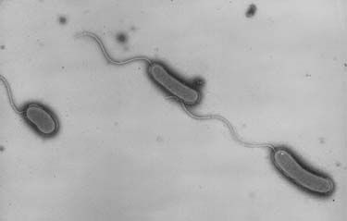
Cholera
What is cholera and how do the symptoms arise?
Cholera bacteria penetrate mucus lining of the small intestine using their flagella.

Slide 4
Cholera
What is cholera and how do the symptoms arise?
Cholera bacteria produce a protein toxin consisting of 2 parts – one part binds to specific glycolipid receptors on the intestine wall. The second part is ingested by the cell.

Slide 5
Cholera
What is cholera and how do the symptoms arise?
Cholera bacteria produce a protein toxin consisting of 2 parts – one part binds to specific glycolipid receptors on the intestine wall. The second part is ingested by the cell.

Slide 6
Cholera
What is cholera and how do the symptoms arise?
Cholera bacteria produce a protein toxin consisting of 2 parts – one part binds to specific glycolipid receptors on the intestine wall. The second part is ingested by the cell.

Slide 7
Cholera
What is cholera and how do the symptoms arise?
Cholera bacteria produce a protein toxin consisting of 2 parts – one part binds to specific glycolipid receptors on the intestine wall. The second part is ingested by the cell.

Slide 8
Cholera
What is cholera and how do the symptoms arise?
The toxin starts a chain of events in the cell which result in chloride channels in the membrane opening.

Slide 9
Cholera
What is cholera and how do the symptoms arise?
The flood of chloride ions out of the cells into the lumen of the small intestine lowers the water potential.
Cl⁻
Cl⁻
Cl⁻
Cl⁻
Cl⁻
Cl⁻
Cl⁻

Slide 10
Cholera
What is cholera and how do the symptoms arise?
What happens to the water potential in the small intestinal lumen?
Cl⁻
Cl⁻
Cl⁻
Cl⁻
Cl⁻
Cl⁻
Cl⁻

Slide 11
Cholera
What is cholera and how do the symptoms arise?
Water floods out of cells into the small intestine by osmosis.
H₂O
H₂O
H₂O
H₂O
H₂O
Cl⁻
H₂O
H₂O
Cl⁻
Cl⁻
H₂O
Cl⁻
H₂O
H₂O
H₂O
H₂O
Cl⁻
Cl⁻
Cl⁻
H₂O
H₂O
H₂O
H₂O

Slide 12
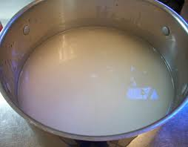
Cholera
What is cholera and how do the symptoms arise?
The increased water causes profuse watery diarrhoea. There is so much diarrhoea that the stools eventually turn into a ‘rice water’ colour.

Slide 13
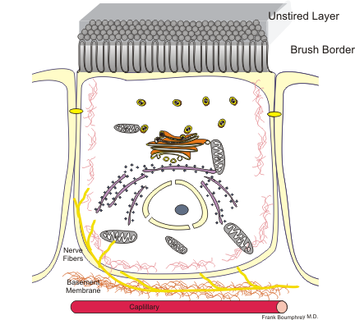
How does the bacterium cause disease?
What is cholera and how do the symptoms arise?
Lumen of small intestine
Toxin
Cl-
Cl-
Chloride Channel
Cl-
Cl-
Water

