Slide 1
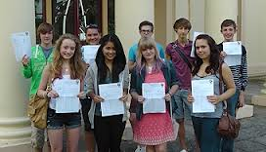
Command Words
I’m glad the science teachers explained to me what the questions meant.
Improving Your Exam Performance
If only I knew what the questions wants from me!

Slide 2
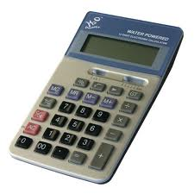
Calculate
You should use the numbers given in the question to work out the answer. You should always show you working, as it may be possible for the examiner to award some marks for the method even if the final answer is wrong.
You should always give the units – sometimes a mark may be awarded for the correct units, even if the
calculation is wrong.

Slide 3
Example of Calculation Question
Example: Chemistry
A drug amphetamine has the formula C₉H₁₃N. The relative molecular mass (Mr) of amphetamine is 135. Calculate the percentage by mass of nitrogen in amphetamine.
Relative atomic mass: N = 14 C=12 H=1
Mass of N 1 x 14 = 14 (14/135) x 100 = 10.37 Percentage of nitrogen = 10.4 %

Slide 4
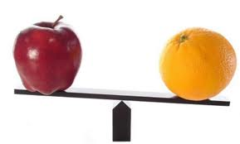
Compare
This requires you to describe the similarities and/or differences between things, NOT just write about one of them. If you are asked to “compare x with y”, you need to write down something about x AND something about y, and should give a comparison.
I’m lighter than you!

Slide 5
Example of Compare Question
Example: Physics
The water in a domestic hot water tank can be heated by solar panels on the roof or by using an electric immersion heater. Compare the advantages and disadvantages of using solar energy to heat the water rather than using an electric immersion heater.
Generating electricity for an immersion heater burns fossil fuels, which releases carbon dioxide into the atmosphere but solar energy doesn’t release any extra carbon dioxide. Solar energy is a renewable energy source, which also means that we are conserving fossil fuels which are in danger of running out. Solar energy does have disadvantages because it needs the daylight and some countries don’t have enough hours of sunlight, like Scotland in the winter. This means there will be times when not enough hot water is available for the household, whereas an immersion heater can supply hot water all of the time.

Slide 6
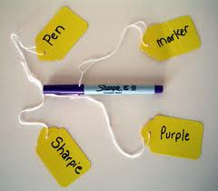
Describe
You should recall some facts, events or process in an accurate way - for example an experiment that you have done. You may need to give an account of what something looked like, or what happened, eg a trend in some data.
What am I?

Slide 7
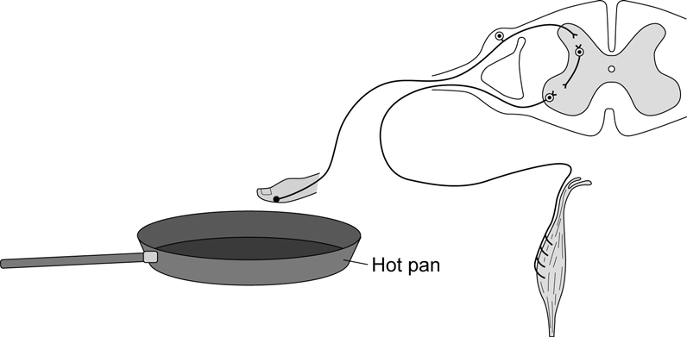
Example of a Describe Question
Example: Biology
A person accidentally touches a hot pan.
Her hand automatically moves away from the
pan. The diagram shows the structures
involved in this action. Describe fully how the
structures shown in the diagram bring about this reflex action.
First of all the heat (stimulus) will be detected by the temperature receptors in the skin. The receptors will send an electrical impulse along the sensory neurone to the synapse in the spinal cord. A chemical messenger is released, which crosses the synapse space and triggers an impulse in the relay neurone. The same thing happens at the next synapse so that an impulse is sent down the motor neurone to the muscle, which is the effector. When the impulse reaches the muscle it causes the muscle to contract and pulls the hand away from the heat. This is a reflex action, which does not have to be processed via the brain.

Slide 8
Evaluate
You should use information supplied or your own knowledge and understanding to consider the evidence for and against and draw conclusions. This goes further than “compare”. For example, you may be given a passage to read and told to “Evaluate the benefits of using system x and system y”. This means you will need to write down some of the pros and cons for both systems, AND then state which one is better and why.
You should complete your answer with a conclusion.

Slide 9
Example of a Evaluate Question
This information about biodiesel was printed in a magazine.
Almost all of the crops we eat can be converted into fuel for cars. Vegetable oils can be used as biodiesel. Diesel from crude oil is called fossil diesel. When either biodiesel or fossil diesel burn they both produce similar amounts of carbon dioxide. Both types of diesel produce carbon monoxide. However, biodiesel produces fewer carbon particles and less sulphur dioxide.
Use the information from the magazine and your knowledge and understanding to evaluate the use of biodiesel compared with fossil diesel as a fuel for cars.
Fossil diesel is mainly used because it is quick to produce from crude oil and so far is cheaper than biodiesel. However, biodiesel has a lot to recommend it as it is a renewable resource whereas crude oil is running out. It is carbon neutral as well as it takes in the same amount of carbon dioxide when the plants are growing as it gives out when burnt as fuel. Although burning biodiesel does produce the same amounts of both carbon dioxide and carbon monoxide as fossil diesel, there is less sulfur dioxide so there will be less acid rain, and less carbon particles which cause global dimming. Also waste oils can be used up to produce fuel. Overall I think we should be using more biodiesel as it is important for us all to reduce our carbon footprint in an effort to halt global warming.

Slide 10
Explain
You should make something clear, or state the reasons for something happening. The points in the answer must be linked coherently and logically. The answer should not be a simple list of reasons.

Slide 11
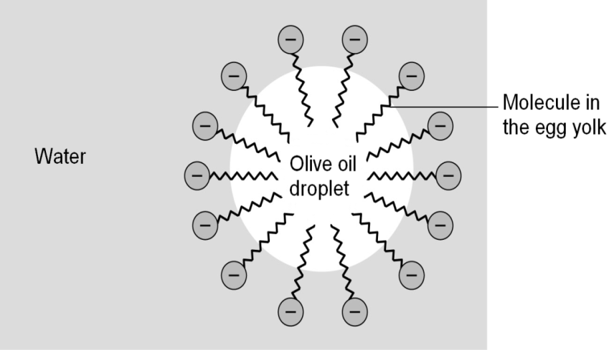
Example of an Explain Question
Example: Chemistry
A mixture of the olive oil, water and egg yolk was shaken and left to stand. The olive oil and water do not separate. The diagram shows a simple model of how a stable mixture of olive oil and water is produced by the addition of egg yolk.
Use this simple model to explain how the molecules in the egg yolk are able to produce a stable mixture of olive oil and water.
The molecules in the egg yolk have a “head” part that dissolves in water, but a long “tail” part that dissolves in oil. A large number of these molecules surround the oil droplet and so it can stay suspended in the water as an emulsion which is stable. The egg yolk molecules act as an emulsifier.

Slide 12
Suggest
This term is used in questions where you need to apply your knowledge and understanding to a new situation. Often there may be more than one correct answer as you are expected to base your answers on scientific knowledge and/or principles.

Slide 13
Example of an Suggest Question
Example: Physics
17 Scientific research carried out in 13 countries has tried to find out if there are any links between using
a mobile phone and developing different types of cancer.
About 13 000 people, half with cancer and half in good health, were interviewed about their mobile
phone use.
Suggest why people in good health were interviewed.
This could be a control group so that the researchers had a group with no cancer to compare their results with.

