Slide 1
How the cardiac cycle is maintained

Slide 2
basics
The heart muscles are myogenic.
This means that the heart is able to control its contractions are controlled within the muscle itself.
Within the right atrium is the sinoatrial node, it is known as the pacemaker in the heart.

Slide 3
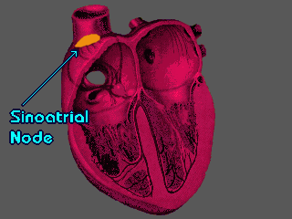
Sinoatrial node (SAN)
A wave of electrical causes both the atria to contract.
This message is stopped from going to the ventricles by a non-conductive tissue

Slide 4
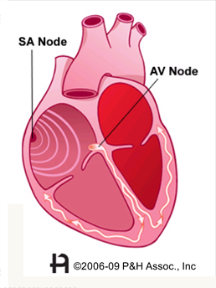
Atrioventricular node (AVN)
The electrical energy passes though the AVN located between the atria.
After a short delay, the AVN conveys a wave of electrical energy between the ventricles along specialised muscle fibres called a bundle of His

Slide 5
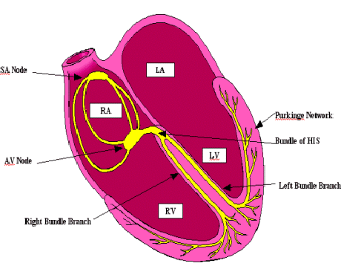
Bundle of His Fibres
The bundle of His conducts the wave through the atrioventricular septum to base of the ventricle., where the bundles branches into smaller fibres
The wave of electrical activity is released from these fibres, this causes the ventricles to contract quickly at the same time, from apex of the heart upwards

