Slide 1
B1 REVISION – CHAPTER 1 – KEEPING HEALTHY
What are the 7 components of a healthy diet?
.
.
.
.
.
.
.
Describe the issues with being overweight
Describe the issues with being underweight
What does it mean to be malnourished?
How does the body control cholesterol levels?
What is the link between health and exercise?
What are the different methods of infection?
What are the differences between bacteria and viruses?
What are antibiotics?
How do they work?
How do our bodies defend against disease?
KEY WORDS:
Malnourished
Metabolic rate
Overweight
Obese
Infectious disease
Microorganism
Pathogens
Viruses
Bacteria
Immune system
Antibiotics
Epidemic
Pandemic
Immunisation
Vaccination
ASSESSMENT:

Slide 2
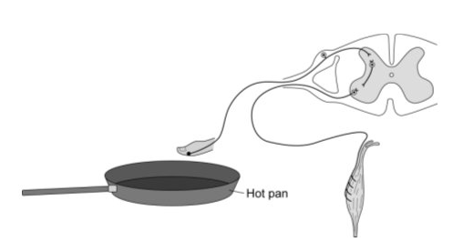
B1 REVISION – CHAPTER 2 – COORDINATION AND CONTROL
Name the five sense organs:
.
.
.
.
.
Fill in the blanks:
Receptor → _________ _________→_________ _________ → _________ _________ → effector
Describe the reflex arc shown in this diagram
What is the menstrual cycle?
Describe how the hormones of the menstrual cycle interact?
FSH
Oestrogen
Progesterone
LH
Draw a diagram of geotropism in roots and shoots:
How are the following conditions controlled:
Temperature:
Blood sugar
Water and ions:
KEY WORDS:
Nervous system
Impulses
Stimuli
Receptors
Neurone
Reflex arc
Synapse
Menstrual cycle
Hormones
Contraceptive
Interval environment
Homeostasis
Photosynthesis
Tropisms
ASSESSMENT:

Slide 3
B1 REVISION – CHAPTER 3 – MEDICINE & DRUGS
What are the features of a good medicine?
What are drugs?
Why are some legal and others illegal?
What is the difference between prescribed and non-prescribed drugs?
How are new medicines developed?
What is a double-blind trial?
What are performance enhancing drugs?
Is it ethical to use performance enhancing drugs?
Describe the issues with thalidomide
Describe the issues with cannabis
KEY WORDS:
Effective
Safe
Stable
Double-blind trial
Placebo
Thalidomide
Statins
Depression
Withdrawal symptoms
Legal
Illegal
Steroids
ASSESSMENT:

